Slide 1
Effective Teaching Strategies for English Language Learners
Enhanced by the Use of Technology
Presented by Karen Sprous, Rolla Public Schools, ELL Teacher
Notes:
QR Codes doc

Slide 2
Key Terms
ESL – English Second Language
ELL – English Language Learner
LEP – Limited English Proficiency

Slide 3
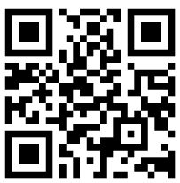
Your Tax Dollars at Work
Scaffolding Options for Teachers of
English Language Learners, K-12
by Linda New Levine, Laura Lukens, and Betty Ansin Smallwood
(EXceptional Collaboration for English Language Learning),
Developed as part of Project EXCELL a partnership between the University of Missouri-Kansas City and North Kansas City Schools under a 2007 National Professional Development Grant from the U.S. Department of Education

Slide 4
Instructional Strategy
The term instructional strategy refers to a generalized learning or teaching technique that is applicable across content areas. Effective teachers have knowledge of a wide array of instructional strategies, and they choose the most effective ones for specific teaching and learning environments (Marzano, 2003; Marzano, Pickering, & Pollock, 2001).
Notes:
Most strategies are content-neutral and can be used flexibly in a variety of teaching environments.

Slide 5
The strategies described here have been chosen to reflect five research based principles of scaffolded instruction for English language learners:
1) to focus on academic language, literacy, and vocabulary;
2) to link background knowledge and culture to learning;
3) to increase comprehensible input and language output;
4) to promote classroom interaction and
5) to stimulate higher order thinking and the use of
learning strategies
These five core principles are essential to academic success for English language learners, representing both research findings and best practices (Levine, Smallwood, &
Haynes, 2012 a, 2012 b).
Notes:
Strategies were chosen because of their usefulness in helping teachers to scaffold content and language input to children in the process of learning English as a new language.

Slide 6
Notes:
Developed as part of Project EXCELL (EXceptional Collaboration for English Language Learning), a partnership between the University of Missouri-Kansas City and North Kansas City Schools under a 2007 National Professional Development Grant from the U.S. Department of Education

Slide 7
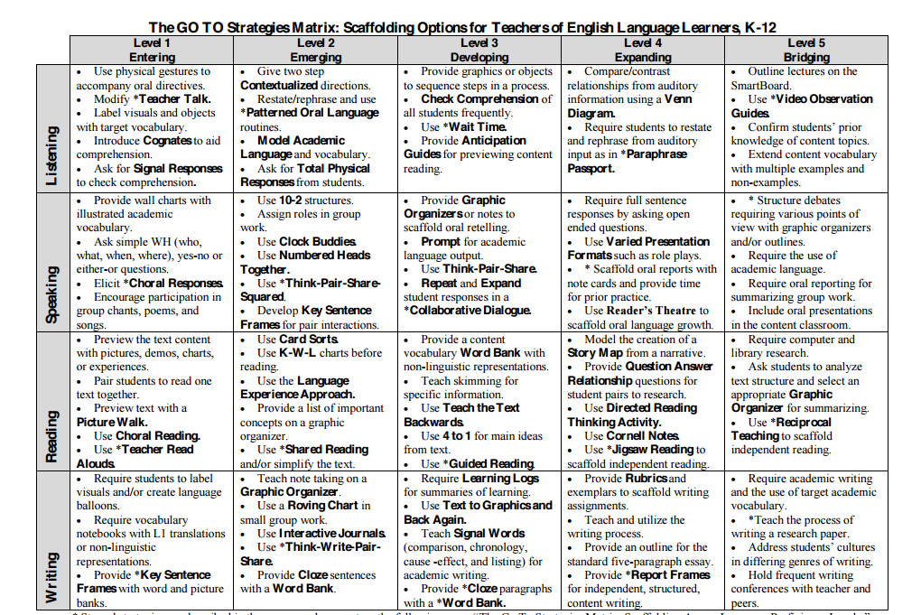
Notes:
The GO TO Strategies Matrix

Slide 8
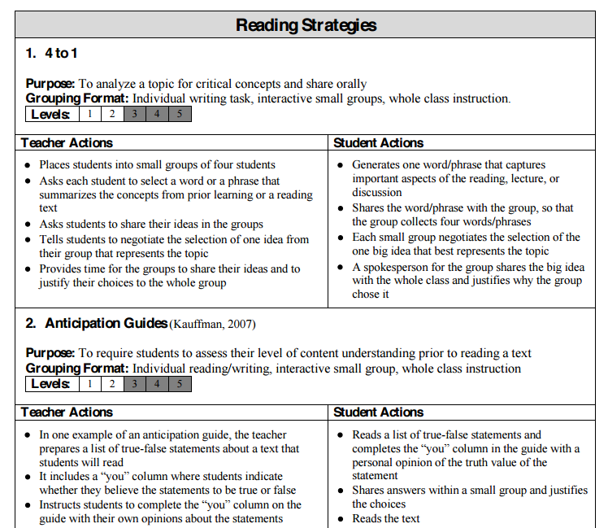
Notes:
NOTE: The shaded boxes indicate the appropriate language proficiency levels for each strategy.

Slide 9
Community Building Strategies
are introduced by the teacher to help develop a sense of community within the classroom and within small groups of students. Examples of community building strategies are Marvelous Modifiers and Whale of a Tale
Notes:
English language learners’ vocabulary, grammar and pronunciation develop faster when there are opportunities for interaction in the classroom using the language being learned (Mackey & Goo, 2007). Interaction among students and with the teacher is crucial in the language acquisition process (Fang, 2010; Gass, 1997; Long, 1983, 1996).

Slide 10
Interactive Strategies
are organized by the teacher to promote oral language development in the classroom. Examples of interactive strategies are Paraphrase Passport and Numbered Heads.
Notes:
English language learners who appear to be fully fluent in English may nonetheless struggle to express themselves effectively in academic settings (Cummins, 2000; Scarcella, 2003; Short & Echevarria, 2005). Research shows that students should be explicitly taught the language skills they need to succeed in the classroom (Saunders & Goldenberg, 2010).

Slide 11
Teaching Strategies
are used by a teacher to scaffold the learning process and promote comprehension of oral or written language by students. Examples of these strategies are Teacher Talk and Wait Time.
Notes:
All students benefit from learning the thinking skills and learning strategies that are used naturally by the highest-performing English language learners (Tharp, Estrada, Dalton, & Yamauchi, 2000; Zohar & Dori, 2003).

Slide 12
Student Learning Strategies
are practiced by students to promote comprehension of content text. Examples of learning strategies are Cornell Notes and Idea Maps.
Notes:
Students should also be given ample opportunity to produce language, and they should receive direct feedback to increase their comprehension and improve their language skills (Saunders & Goldenberg, 2010; Short & Echevarria, 2005; Swain, 2005).

Slide 13
Vocabulary Teaching Strategies
are introduced into a learning unit to help students learn the academic vocabulary required for high achievement in schools. Examples of vocabulary strategies are Word Squares and Sort Tasks.
Notes:
Research shows that students should be explicitly taught the language skills they need to succeed in the classroom (Saunders & Goldenberg, 2010)

Slide 14
Reading Strategies
are taught to students to promote comprehension of written texts. Examples of reading strategies are Language Experience Approach and Anticipation Guides.
Notes:
: English language learners who appear to be fully fluent in English may nonetheless struggle to express themselves effectively in academic settings (Cummins, 2000; Scarcella, 2003; Short & Echevarria, 2005).

Slide 15
Writing Strategies
are taught by the teacher to enable students to develop academic writing abilities. Examples of writing strategies are Text to Graphics and Back Again and Report Frames.
Notes:
English language learners learn both through the language they encounter (input) and the language they produce (output). Input should be at a level that is challenging but nonetheless comprehensible (Krashen, 1985).

Slide 16
Influence of Technology
translate
videos and podcasts
websites and games
computer software
apps
BYOD bring your own devices
brick and mortar versus online
Notes:
Google has changed my life! Examples of everything we use to learn/teach.

Slide 17
Reference and Resource
Levine, L. N., Lukens, L., & Smallwood, B. A. (2013). The GO TO strategies: Scaffolding options for teachers of English language learners, K-12. For Project EXCELL, a partnership between the University of Missouri- Kansas City and North Kansas City Schools, funded by the US Department of Education, PR Number T195N070316.
http://www.kammsolutions.com/wp-content/uploads/2015/07/ELL_go-to-strategies-1.pdf#page=10

